Slide 1
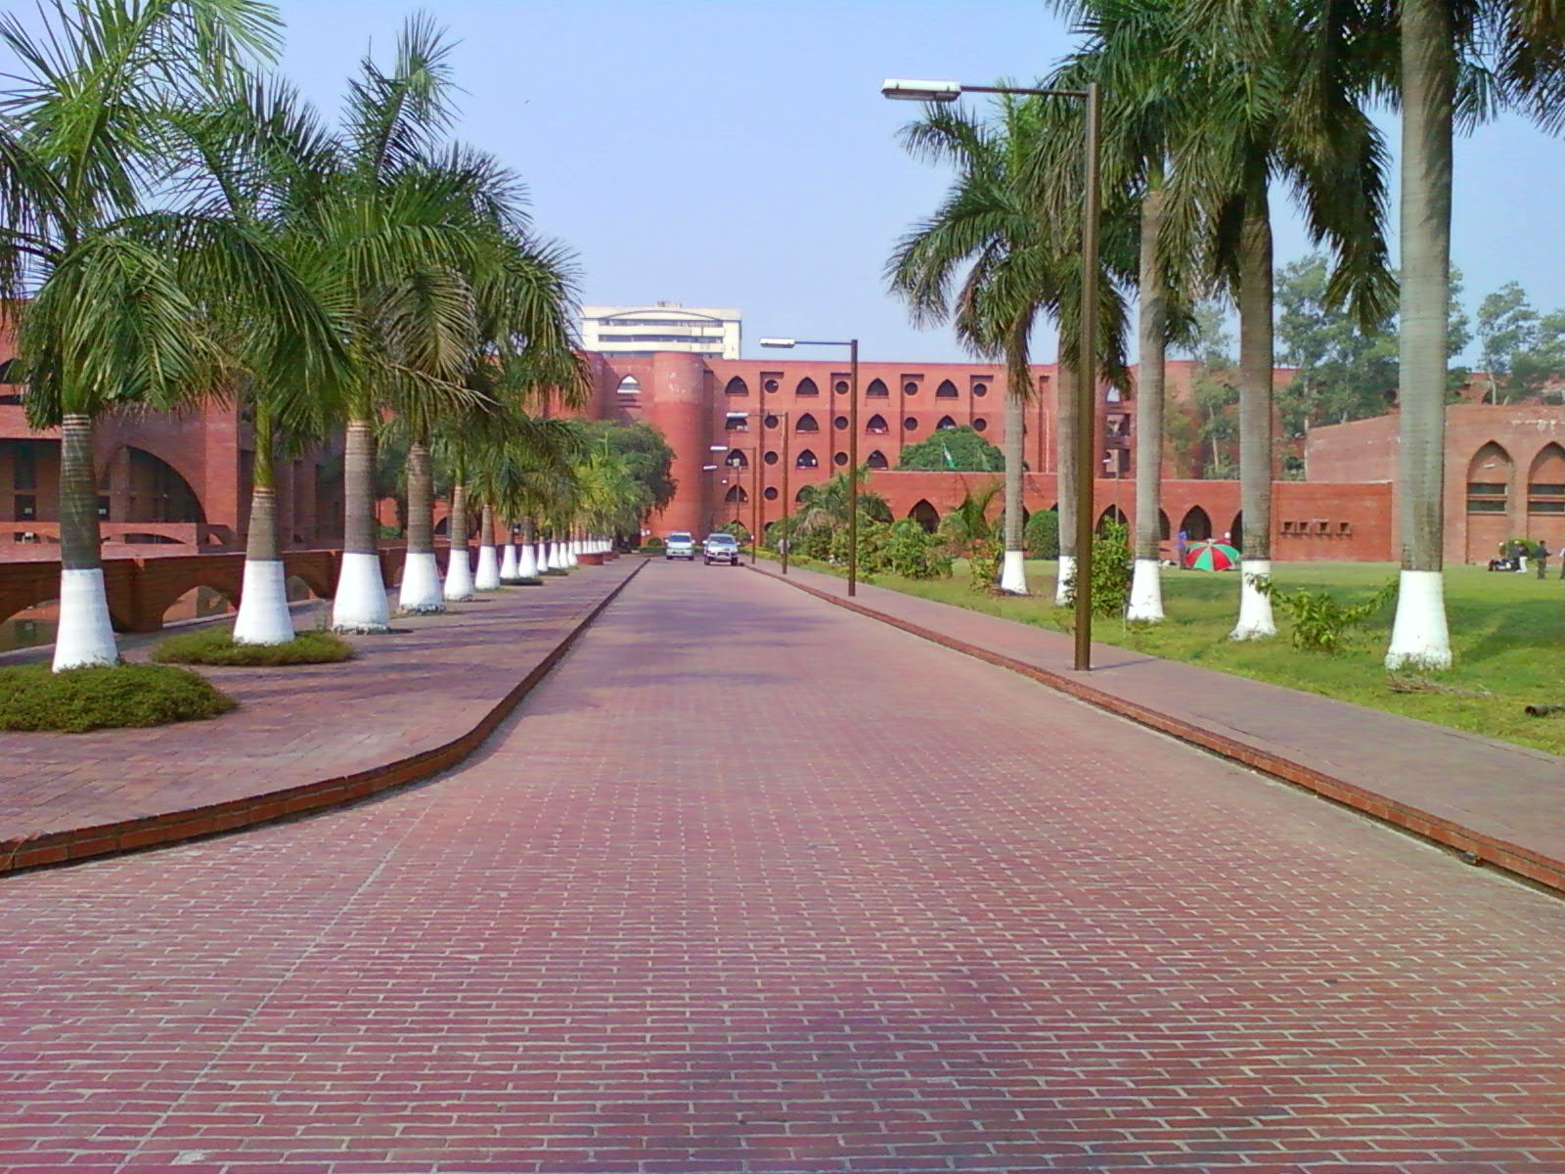
WELCOME TO
K
G
B
GENERAL
KNOWLEDGE
BOASTER

Slide 2


THE GAME’s OBJECTIVES
1.
To improve on the general knowledge of the user.
2.
To improve on the user’s thinking speed.
3.
For Fun!

Slide 3







THE GAME’s FEATURES.
+
6
0
0
GENERAL KNOWLEDGE
1
Q’s & A’s.
ABILITY TO CREATE MULTIPLE PLAYERS ACCOUNTS.
2
PROTECTED WITH PASSWORDS
SETTINGS ACCORDING TO USER’S PREFFERENES.
3
And many other Features Of Fun!

Slide 4



Complexity Of The Game
Use of header files
Time functions.
Others
The game uses different header files accomplish its tasks.
The games uses Time functions in awarding points.
Structures
Pointers
Files
Math

Slide 5





GKB Developers
160040007
160040009
THANK YOU 4 LISTENING.
160040006

